Slide 1
Tag Registration & Printing Process
Tagging Process
Dispatching Center
Receiving Center
Proposed RFID H/W
RFID Based Bag Counting Solution
Generic Consultancy - Railway Project
Stallion systems & solutions Pvt. Ltd

Slide 2


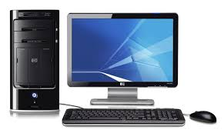
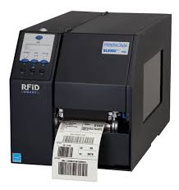
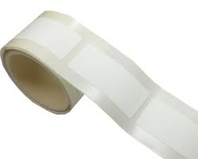
Tag Registration & Printing Process
RFID Plant Server
ERP Web Server
RFID middleware application will print on RFID tags with Batch No., Lot No., Manufacturing date, Date & Time and UID number.
Process:
User will request codes from ERP web application .
User will get encrypted code file, decrypt the code file.
User will create batch in RFID Plant application.
User will print the RFID tags through RFID Printer using RFID middleware application.
Tag Printing

Slide 3
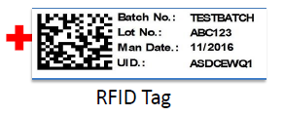

Tagging Process
Pasting the tag
bags
RFID Tagged bags
User will apply the RFID tags on bags using Manual label pasting

Slide 4
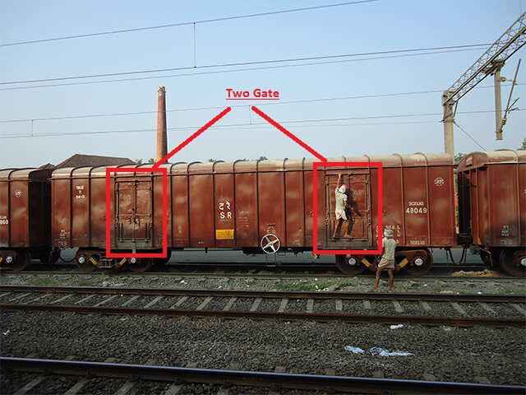
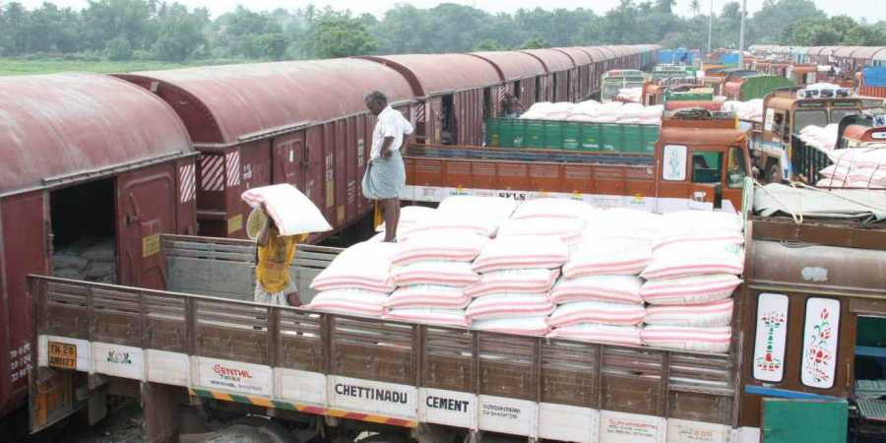
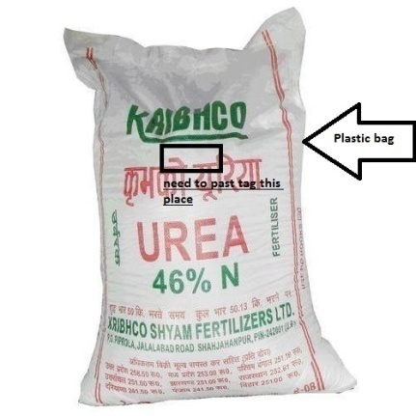
Existing Process
Two entry gate
Bag
Existing process

Slide 5
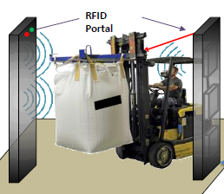

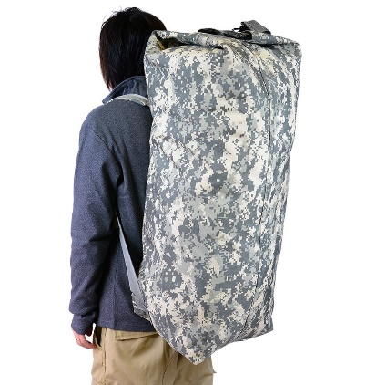


Dispatching Center
RFID Server
ERP Web Server
RFID Tagged bags
Manual
Manual carrying RFID tagged Bag
For Dispatch user will pass the bags through RFID gate to dispatch
RFID Middleware System

Slide 6
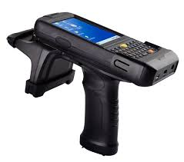


Physical Inventory of Bag (Optional)
RFID Plant Server
RFID Web Server
RFID Tagged Bag
Wired Link
The User will scan dispatching Bag or take physical inventory through RFID handheld Reader.
RFID Middleware System

Slide 7


ERP Web Server
RFID Plant Server
Receiving Center
RFID Tagged HDPE Bag
Manual
Manual carrying RFID tagged Bag
The Bag will passing through RFID Gate reader and simultaneously Bag ID (IN Count) will be recorded into the server.
RFID Middleware System

Slide 8
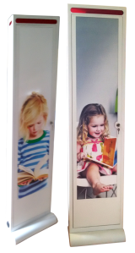
Proposed hardware
STA AN86609C
Alien ALR-F800 Reader
ALR-H450
RFID Paper Tag
STA Anti-theft Gate reader
RFID Printer

Slide 9

Thank You

